Slide 1
VIP: Design Notebooks
Julie Sonnenberg-Klein
Academic Program Manager
Vertically Integrated Projects Program

Slide 2
Documentation & Design Notebooks
Weekly assignments won’t be like regular HW
Read research papers, equipment documentation
Research ways to design/build/program
Up to elbows in wires or foam rubber
Instructor won’t grade you every week
You’ll document everything you do in a design notebook
2 notebook evaluations: midterm & final

Slide 3
Design Notebook Justification for your Grade
Come to class, open your design notebook
Write down the date
Take notes
Write to-do lists
Subteam meeting, open your design notebook
Date, attendees
Take notes
Write to-do lists, questions

Slide 4
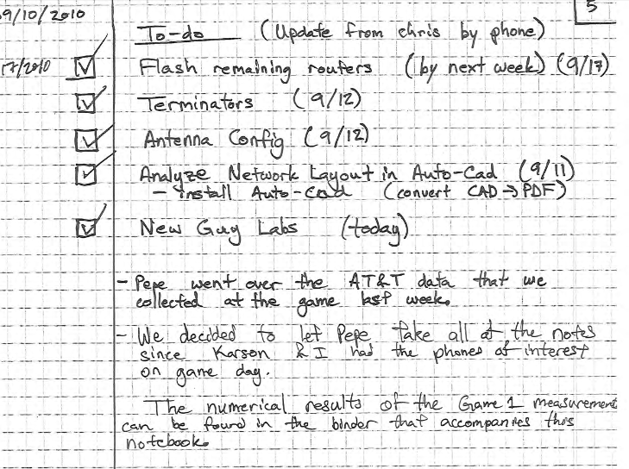
To-do List Example
Clear checkboxes
Noted dates items completed
Wrote notes on list items below list.

Slide 5
As You Work
Date every page
Initial every page
Above & beyond: sign-off on each other’s pages
Include
Technical notes
Design decisions
Important websites
Copies or pointers to code
You have Intellectual Property rights
Notebook documents your contributions

Slide 6
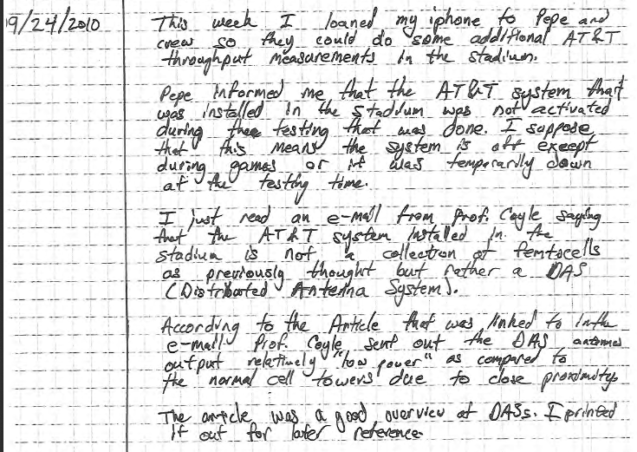
Narrative Example

Slide 7
Design Notebook Evaluations
Midterm (before drop with a W deadline)
Finals
Main place to prove what you’ve done
Note in the notebook? It didn’t happen.
No notes from subteam meeting? You didn’t go.
No checklists for the first three weeks? You must not have done anything.
Don’t want a blank notebook

Slide 8
What You Need
Bound notebook
Big, small, whatever
Lined, graph paper, whatever
Inner and/or outer Cover:
Name
Team
Semester
Your contact information
Team members’ names, cell numbers, emails (inside)
Number all of the pages

